Slide 1


K.RAMAKRISHNAN COLLEGE OF TECHNOLOGY
(AUTONOMOUS), TRICHY.
DEPARTMENT OF
COMPUTER SCIENCE AND ENGINEERING
20CS5501 DESIGN PROJECT-1
Batch No. : 18
Date : 05.12.2024

Slide 2
Food Recipe Recommendation
Based on Ingredients
Guided by Team
Mr.P.Matheswaran,M.E.,(Ph.D)., DEVADHARSHINI S (811722104028)
Assistant Professor, CSE DHIVYA S (811722104034)
GAYATHRI R (811722104043)

Slide 3
OBJECTIVE OF THE PROJECT
Ingredient-Based Dish Suggestions: The system will take an ingredient as input and provide a list of possible dishes that can be prepared using that ingredient.
Promote Healthy Eating Habits: By suggesting dishes based on user inputs, the system can encourage users to make healthier food choices by offering balanced meals that are both nutritious and delicious.
User-Friendly Experience: The application aims to provide a simple and intuitive interface for users to enter an ingredient and instantly receive a variety of dish recommendations.
To optimize ingredient usage and reduce food waste by offering creative recipe options.To cater to user preferences, including dietary restrictions, taste preferences, and regional cuisines.
To incorporate personalization features that learn user preferences over time for tailored recommendations.

Slide 4
ABSTRACT
This project aims to design and implement a food recipe recommendation system that enables users to discover recipes tailored to their ingredients,and culinary interests.
The system leverages data-driven techniques to analyze user input, suggest diverse and innovative recipes, and minimize food waste by utilizing leftover ingredients effectively.

Slide 5
LITERATURE SURVEY
TITLE OF THE PAPER | AUTHOR (S) | PUBLISHER | PAPER GIST | TECHNOLOGY USED
Personalized Recipe Recommendations Using Deep Learning | Zhang, Y., and Cook, P. | ACM Transactions on Intelligent Systems and Technology | To create a recommendation system that tailors recipe suggestions based on users’ individual tastes, dietary restrictions, and historical behavior patterns. | Deep Learning, Recurrent Neural Networks (RNNs)
A Context-Aware Food Recommendation System Based on Ingredients and Nutrition | Min, W., Jiang, S., and Wang, J. | IEEE Access | The system leverages context-aware computing, machine learning, and nutrition analysis to align food recommendations with user preferences | Context-Aware Computing, Machine Learning, Nutrition Analysis
Food Recommendation System for Healthy Diet Planning Using Machine Learning | Saini, A., and Kaur, S. | International Journal of Computer Applications | aimed at assisting individuals in planning a healthy diet tailored to their preferences, nutritional needs, and health goals. | Machine Learning, Collaborative Filtering
Smart Fridge: Food Management and Waste Reduction Using IoT and Machine Learning | Kumar, R., and Bhatia, V. | Springer, Smart Innovation, Systems, and Technologies | offers an intelligent and automated way to monitor, manage, and optimize food storage. | Internet of Things (IoT), Machine Learning, Cloud Computing
Reducing Food Wastage by Using an Ingredient-Based Recipe Suggestion System | Rao, A., and Sharma, R. | Journal of Food Engineering and Informatics | To reduce the environmental impact caused by food wastage. | Data Mining, Natural Language Processing (NLP)

Slide 6
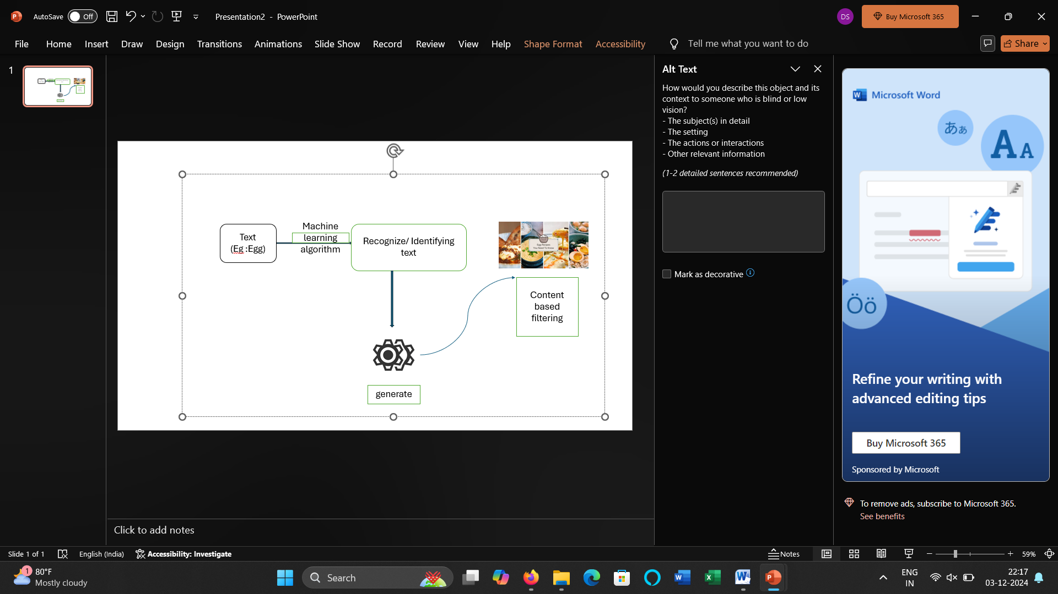
PROPOSED SYSTEM ARCHITECTURE

Slide 7
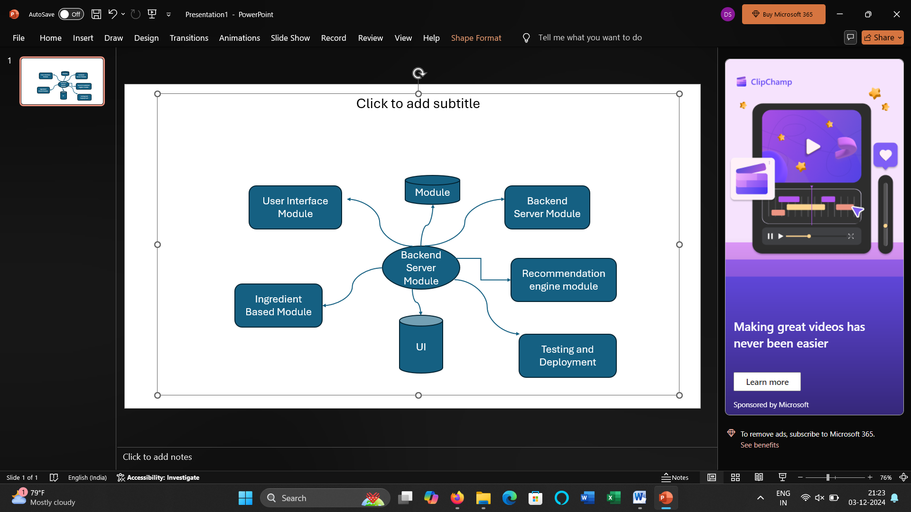
EXISTING SYSTEM ARCHITECTURE

Slide 8
SOFTWARE AND HARDWARE REQUIREMENTS
HARDWARE
SOFTWARE
Java script
HTML
CSS
Visual Studio code
Processor - Intel i5
RAM - 8GB
Storage - 256 GB SSD
Server Requirements – Internet
Connection

Slide 9
MODULES
User Interface (UI) Module
Ingredient and Recipe Module
Recommendation Engine Module
Backend Server Module
Testing and Deployment Module

Slide 10
SUMMARY OF MODULE-1
1. User Interface (UI) Module
The User Interface Module is the front-end component of the Recipe Recommendation System, responsible for enabling users to interact with the application in an intuitive and visually appealing way.
Key Features and Functions:
Home Page:
Welcome screen with options to input ingredients or explore recipes.
2.Ingredient Input Section:
Simple and clean input fields for users to add ingredients manually.
2.Image upload feature for recognizing ingredients (optional).

Slide 11
3. Recipe Details Page:
Display full recipe information:
List of ingredients.
Nutritional information and serving size.
4. Recipe Display Page:
Show a list of suggested recipes with relevant information:
Recipe name.
Image of the dish.
Filters and sorting options for better navigation.
Goals of the UI Module:
Ease of Use: Ensure the design is intuitive, even for non-technical users.
Visual Appeal: Use clean layouts, appealing images, and user-friendly color schemes.

Slide 12
SUMMARY OF MODULE-2
2. Ingredient and Recipe Module
The Ingredient and Recipe Module is the backbone of the Recipe Recommendation System, responsible for storing, organizing, and retrieving data related to ingredients and recipes. It ensures efficient matching between user inputs and recipe suggestions.
Key Features and Functions:
Ingredient Database:
Storage of Ingredients:
Maintain a list of all available ingredients, categorized by type (e.g., vegetables, meats, spices).
Attributes:
Name, category.
Search and Matching:
Enable efficient lookup for user-provided ingredients.

Slide 13
Goals of the Module:
Efficiency: Ensure quick retrieval and matching of ingredients to recipes.
Scalability: Allow for future expansion of ingredients and recipes.
Accuracy: Provide precise matches while supporting ingredient flexibility.

Slide 14
SUMMARY OF MODULE-3
3.Recommendation Engine Module
It is the core of the Recipe Recommendation System, responsible for analyzing user input (ingredients, preferences, etc.) and generating personalized recipe suggestions. This module ensures relevant and accurate recommendations, enhancing the user experience.
Key Features and Functions:
Ingredient Matching:
Identify recipes based on the ingredients provided by the user.
Exact Match: Recipes that use only the listed ingredients.
Partial Match: Recipes requiring minimal additional ingredients.
2. Personalized Recommendations:
User to suggest similar or complementary dishes.
Adapt recommendations to user preferences and cooking habits over time.

Slide 15
4. Advanced Filtering Options:
Allow users to filter results based on cooking time, difficulty, cuisine, or dietary restrictions.
Include dynamic filters like “Quick Recipes” or “High-Protein Dishes.”
Goals of the Module:
Relevance: Ensure recipe suggestions closely match user input and preferences.
Adaptability: Improve recommendations over time using user data.
Efficiency: Provide results quickly, even with large recipe datasets.

Slide 16
SUMMARY OF MODULE-4
4. Backend Server Module
The Backend Server Module is the engine that processes requests from the user interface, communicates with the database, and handles the logic for the Recipe Recommendation System. It acts as the middle layer between the front-end interface and the data layer, managing all the application’s core functionalities.
Key Features and Functions:
Business Logic Processing:
Ingredient Matching Logic:
Process user inputs (ingredients, preferences) and pass them to the recipe matching engine.
Recipe Recommendation:
Run algorithms to filter, rank, and suggest recipes based on matching logic and user preferences.

Slide 17
Goals of the Module:
Efficiency: Ensure smooth, fast processing of user requests and data management.
Security: Safeguard user data and interactions, especially around user accounts and preferences.
Scalability: Allow the backend to grow and handle large amounts of recipe and user data.

Slide 18
SUMMARY OF MODULE-5
5.Testing and Deployment Module
It ensures that the Recipe Recommendation System is functioning as intended and is ready for public use. It covers the processes of validating the system’s functionality, performance, and security before launching and during its maintenance.
Key Features and Functions:
Testing
1. Functional Testing
Test various inputs, including:
Single ingredient (e.g., "chicken") to confirm correct matching.
Multiple ingredients (e.g., "chicken, curry") for combined matches.
Non-matching ingredients to ensure proper "no recipes found" behavior.
Check if the search is case-insensitive and handles extra spaces around ingredients correctly.
2. Validation Testing
Add input validation for ingredients, ensuring users enter meaningful data (e.g., not just commas or numbers).

Slide 19
Goals of the Module:
Quality Assurance: Ensure the system functions correctly, is secure, and can handle real-world usage.
Efficiency: Automate testing and deployment to reduce errors and speed up the development cycle.
Scalability and Availability: Ensure the system can handle increasing traffic and is available to users with minimal downtime.

Slide 20
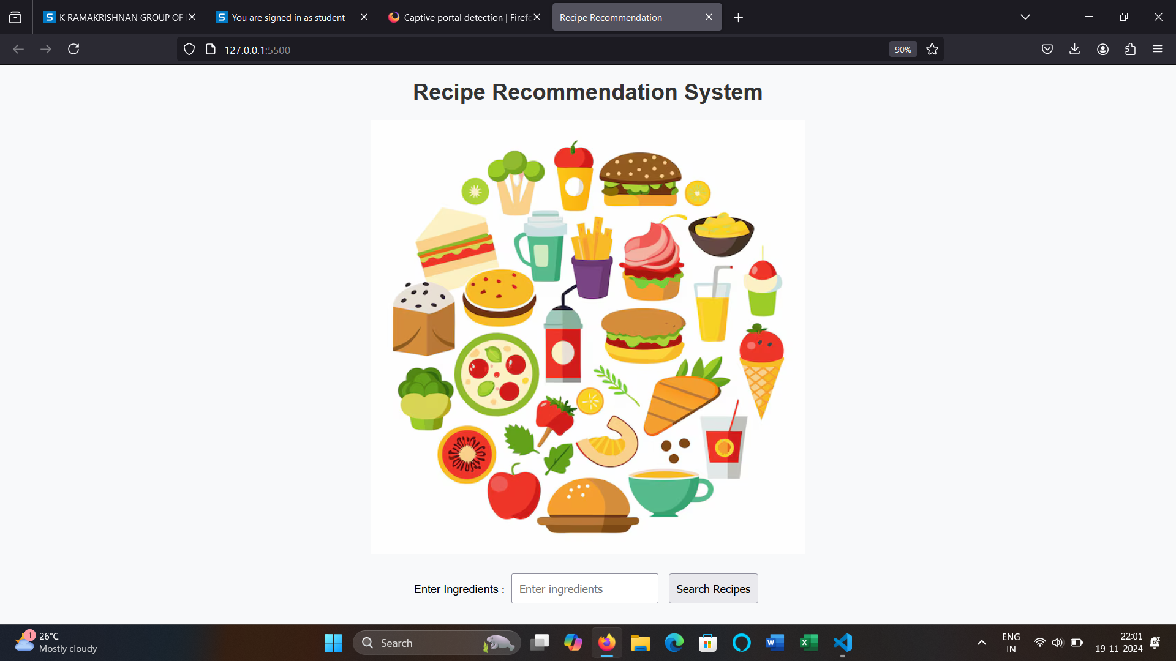
RESULTS AND DISCUSSION

Slide 21
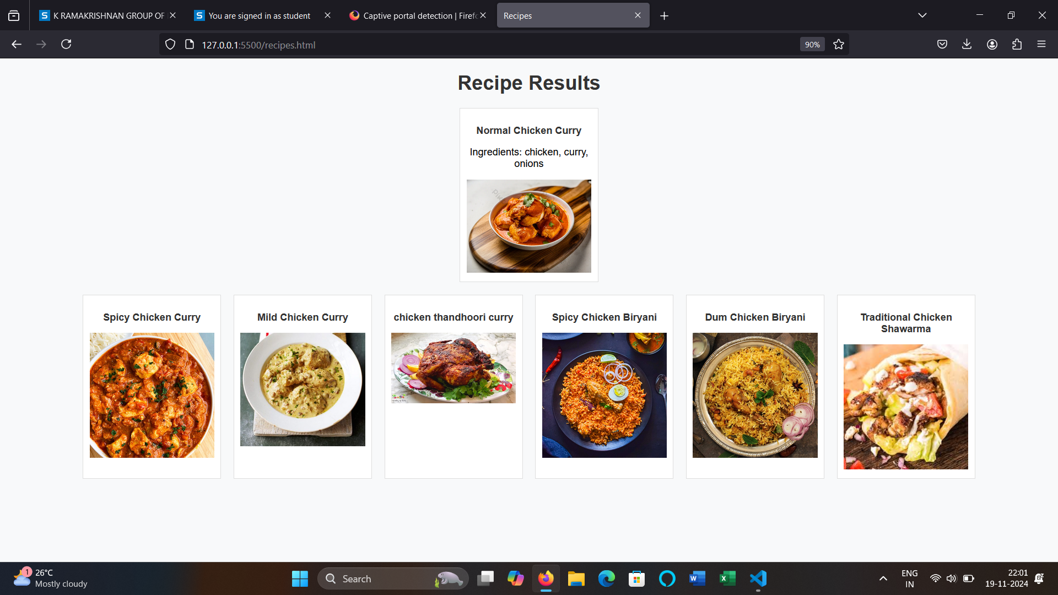

Slide 22
CONCLUSION
The system successfully matches recipes based on available ingredients, offering relevant and creative meal options for users.
With a simple, intuitive interface, users can easily input ingredients and receive personalized recipe suggestions.
Upcoming features like meal planning, grocery list generation, and improved personalization will further enhance user experience.
This project not only helps users create meals with what they already have but also encourages cooking creativity while reducing food waste.

Slide 23
THANK YOU

